Slide 1
CMPS453
Maximizing Function Value with Genetic Algorithms: Solved Example
2/4/2024
Ali El-Zaart

Slide 2
Introduction
In this example, we will explore the use of genetic algorithms to maximize the value of a given function. We will walk through a solved example and discuss each step of the genetic algorithm process. Genetic algorithms are optimization techniques inspired by the principles of natural selection and genetics. They are widely used in various fields, including computer science, engineering, and finance. By applying genetic algorithms, we can find optimal solutions to complex problems that traditional algorithms may struggle to solve.

Slide 3
Problem Definition
The problem we will be working on involves maximizing a given function. The function, denoted as f(x), is defined as f(x) = -x^2 + 2x, with the value of x ranging from 0 to 2. The goal is to find the value of x that maximizes the output of this function. To solve this problem, we will apply the genetic algorithm methodology.

Slide 4
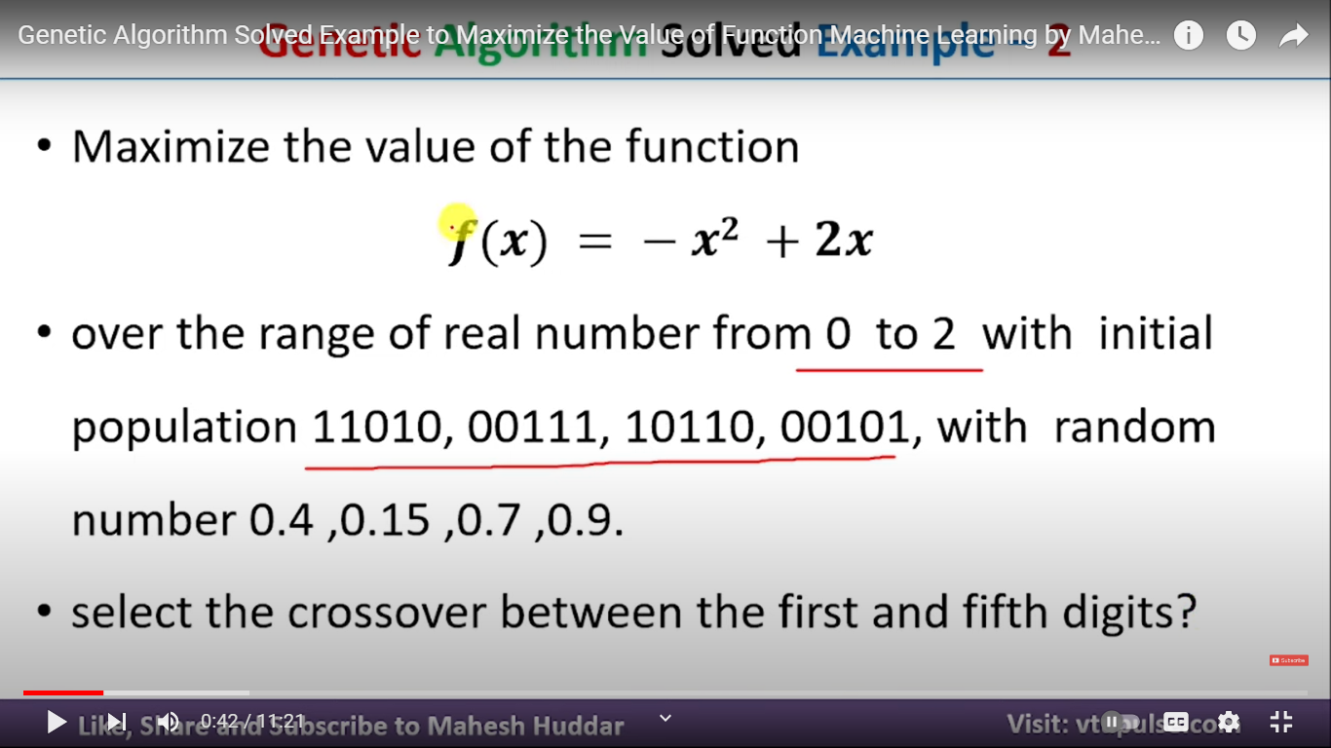
Given

Slide 5
Encoding Technique
Before we dive into the solution, we need to determine the encoding technique for representing the potential solutions. In this case, the minimum value of x is 0, and the maximum value is 2. The chromosomes in the initial population are given as binary strings, each consisting of five digits (0 or 1). Since the problem definition already provides the chromosomes, there is no need to encode the solution further.

Slide 6
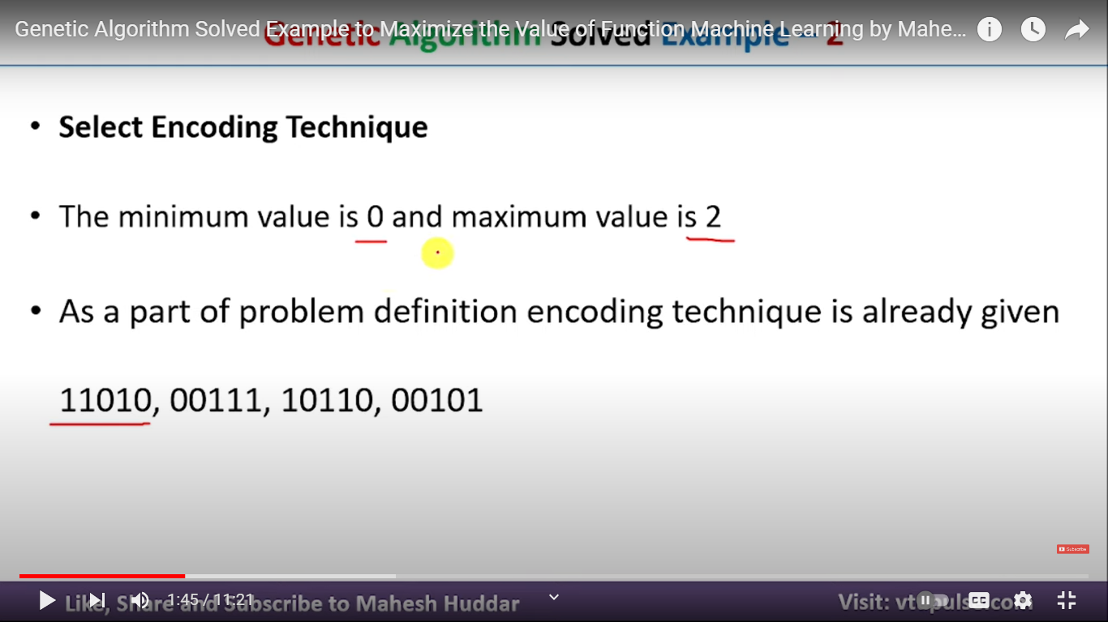

Slide 7
Initial Population Selection
The genetic algorithm starts with an initial population of potential solutions. In our example, we are given a set of four chromosomes as the initial population. Each chromosome represents a possible solution to the problem.

Slide 8
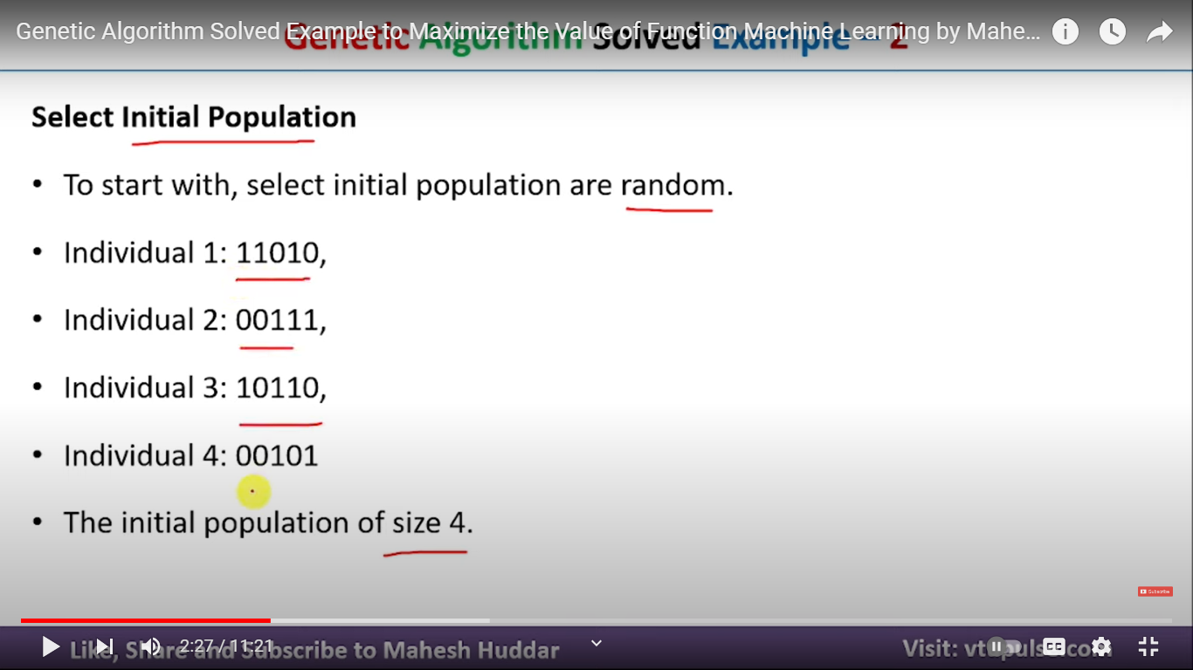

Slide 9
Function Calculation
To assess the quality of each chromosome, we need to calculate their fitness scores. In our case, the fitness score is determined by evaluating the given function f(x) with the corresponding value of x for each chromosome. By plugging in the x value into the function, we obtain a fitness score for that chromosome.

Slide 10
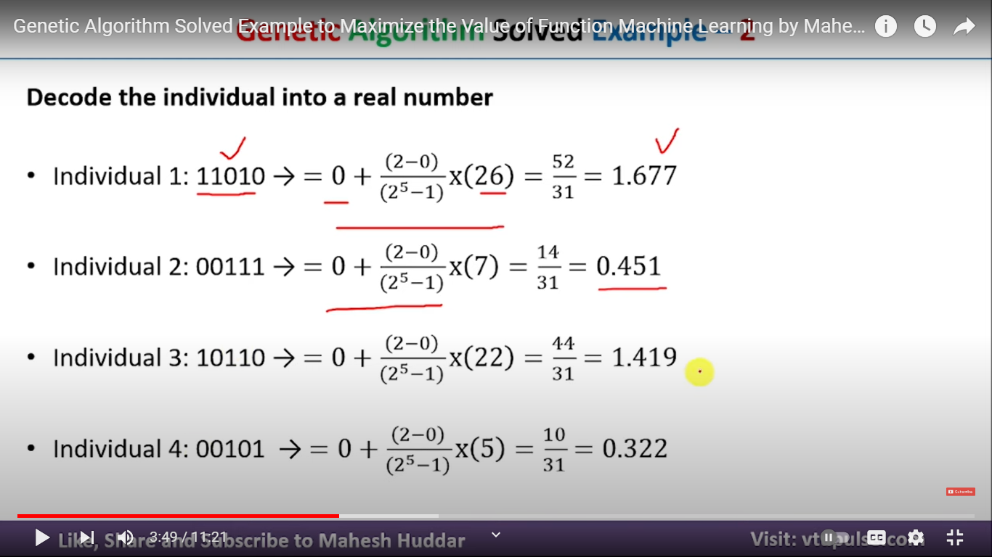

Slide 11
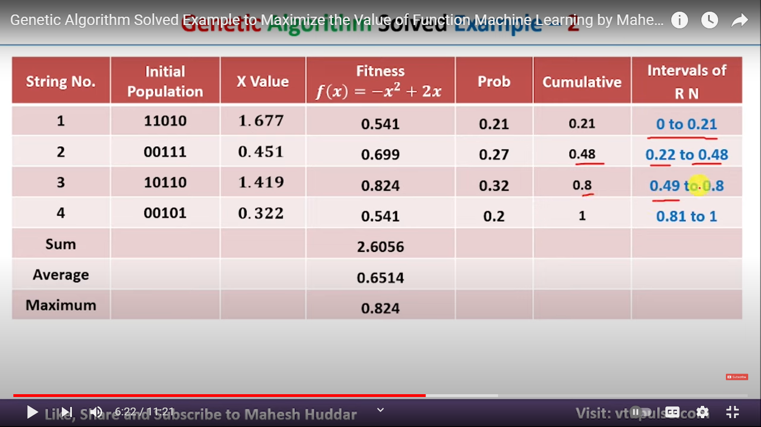

Slide 12
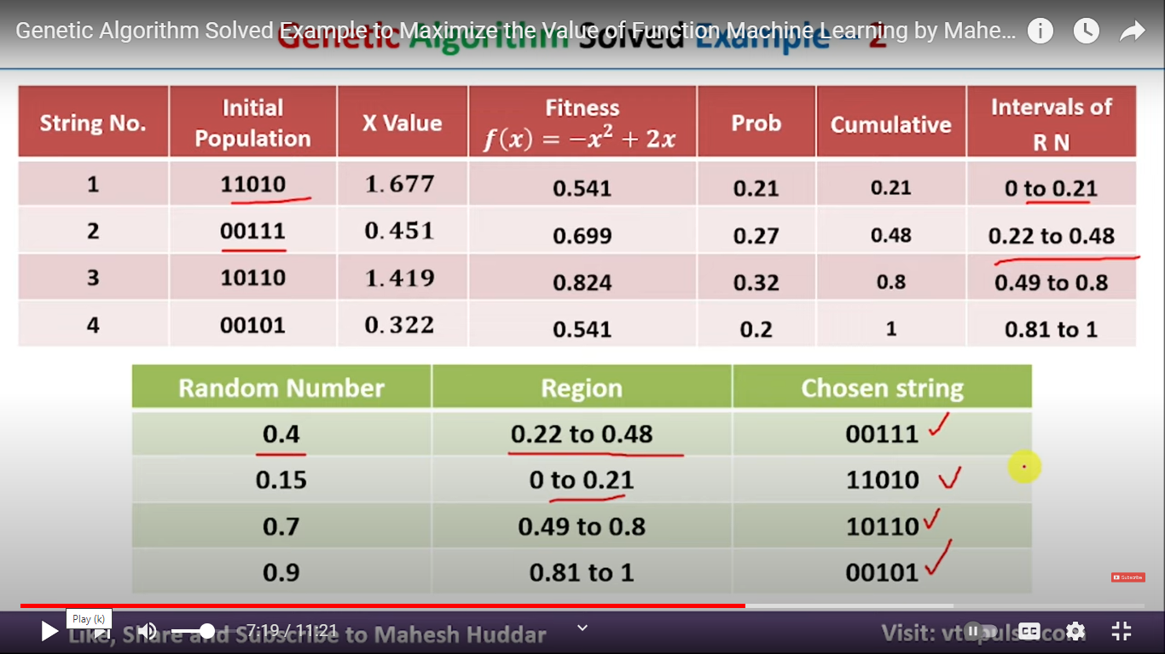

Slide 13
Selection for Crossover
Once the fitness scores are calculated, we select the best chromosomes from the initial population to undergo crossover. The selection is based on their fitness scores, where higher scores indicate better-fit solutions. The selection process uses a probability-based approach, where each chromosome's probability of being selected is proportional to its fitness score. This probabilistic selection ensures that chromosomes with higher fitness scores have a greater chance of being selected for crossover.

Slide 14
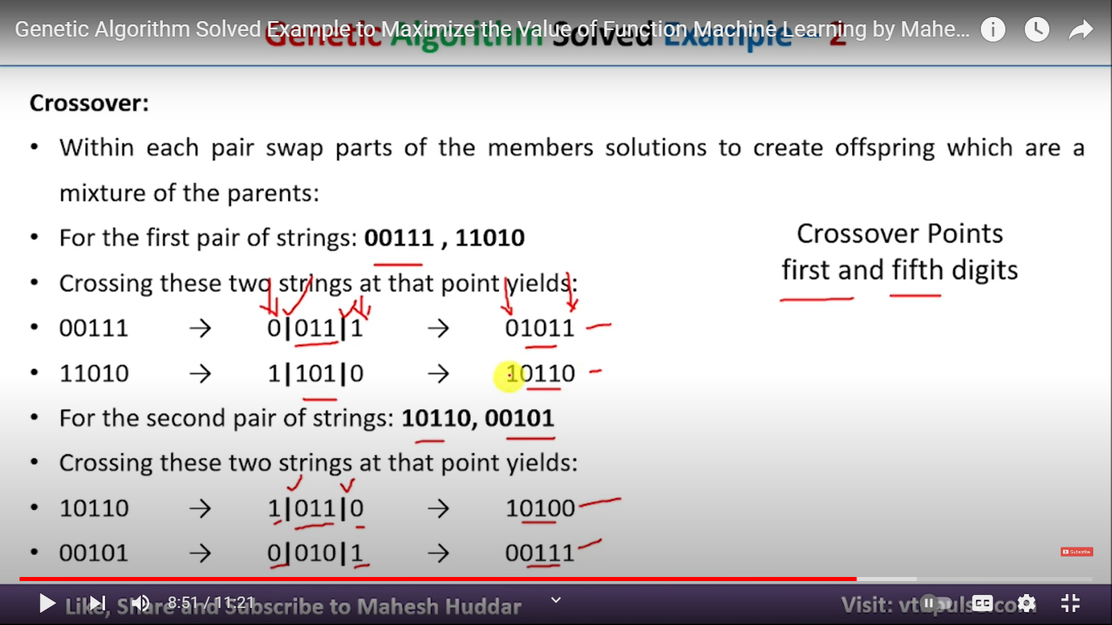

Slide 15
Crossover Process
The crossover is the key operator in genetic algorithms, inspired by natural reproduction. In this process, pairs of chromosomes are selected for exchanging genetic material to create new offspring. The crossover points are predetermined, indicating which portions of the chromosomes will be swapped. This mechanism enables the exploration of different combinations of genetic material, leading to potentially better solutions in the next generation.

Slide 16
Decoding Chromosomes
After the crossover, the resulting chromosomes need to be decoded to obtain their corresponding x values. By using the previously established encoding technique, we can convert the binary chromosomes back into decimal values within the range of 0 to 2. This step generates the potential solutions for the next generation.

Slide 17
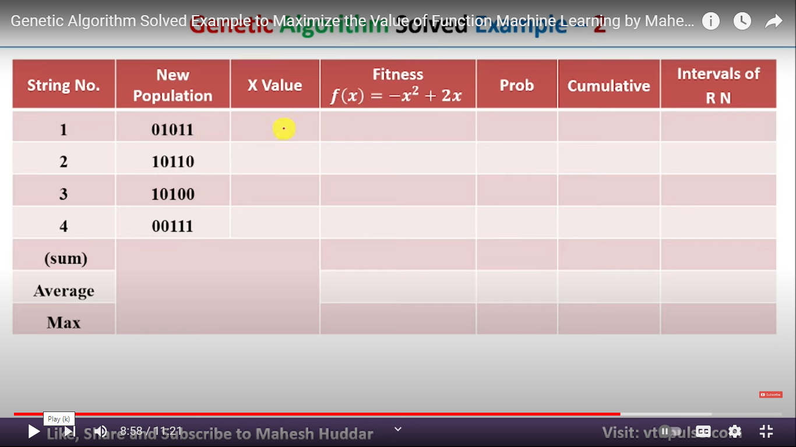

Slide 18
Fitness Score Calculation
Once the decoded x values are obtained, we need to calculate the fitness scores for the new offspring. This involves plugging in the decoded values into the function f(x) to evaluate their fitness. The same fitness function used for the initial population is applied to each offspring.

Slide 19
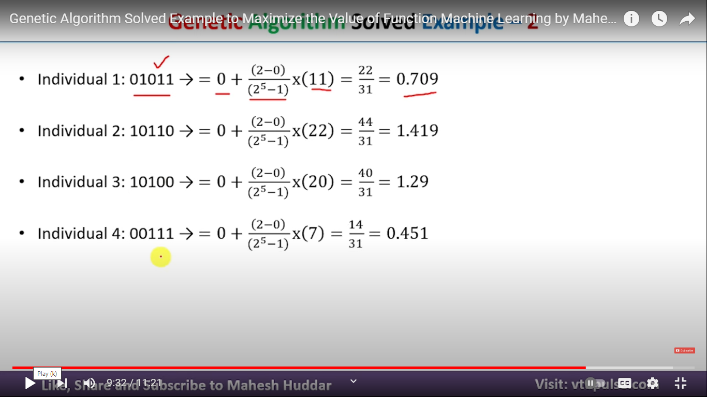

Slide 20
Next Generation
After calculating the fitness scores for the offspring, we select the best chromosomes from this new generation to continue the process. The next generation becomes the new initial population, and the steps of selection, crossover, decoding, and fitness score calculation are repeated.

Slide 21
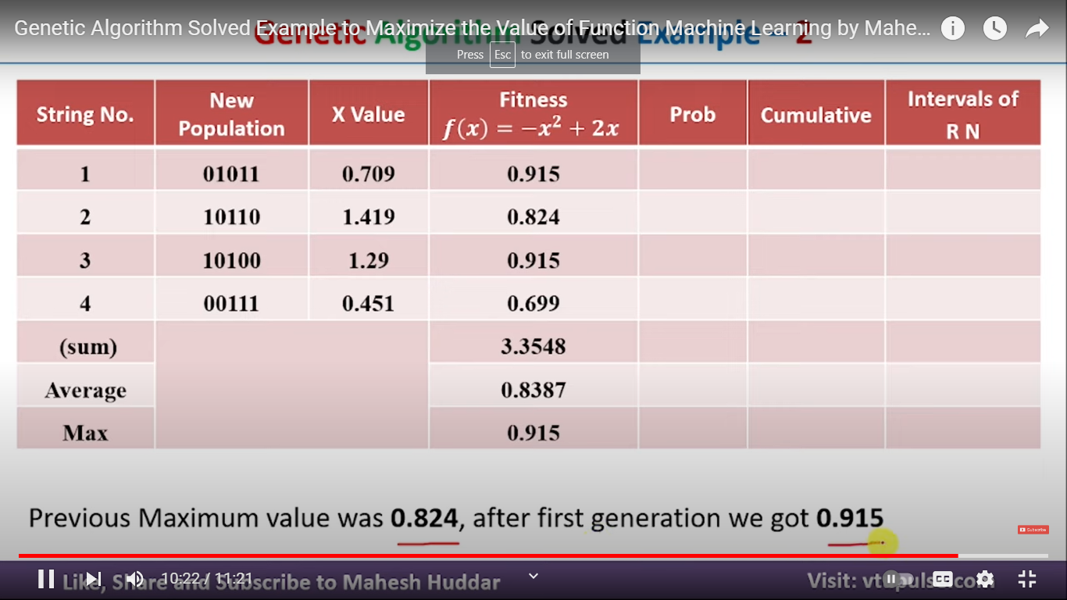

Slide 22
Repeat the Process
To further improve the fitness score for the given function, we repeat the genetic algorithm process for a defined number of iterations or until a satisfactory solution is obtained. Each iteration consists of selection, crossover, decoding, and fitness score calculation steps.

Slide 23
Conclusion
In conclusion, genetic algorithms provide a powerful optimization technique for finding optimal solutions to complex problems. By following the steps of encoding, initial population selection, fitness score calculation, selection for crossover, crossover process, decoding chromosomes, fitness score calculation, and generation iteration, we can leverage genetic algorithms to maximize the value of a given function. The flexibility of genetic algorithms makes them applicable to various problem domains, offering a promising approach for optimization tasks.

Slide 24
Highlights
Genetic algorithms maximize the value of a given function using principles inspired by natural selection and genetics.
The encoding technique represents potential solutions to the problem.
The initial population consists of chromosomes, which are potential solutions.
The fitness function evaluates the quality of each chromosome.
Selection for crossover is based on the fitness scores of the chromosomes.
Crossover exchanges genetic material between pairs of chromosomes.
Decoding converts the chromosomes back into their corresponding values.
Fitness score calculation reevaluates the fitness of the offspring.
The process is repeated iteratively to improve the fitness score.
Genetic algorithms offer a powerful optimization technique for complex problems.

Slide 25
Other example : f(x)=x^2
https://www.youtube.com/watch?v=udN28wPqaZI

Slide 26
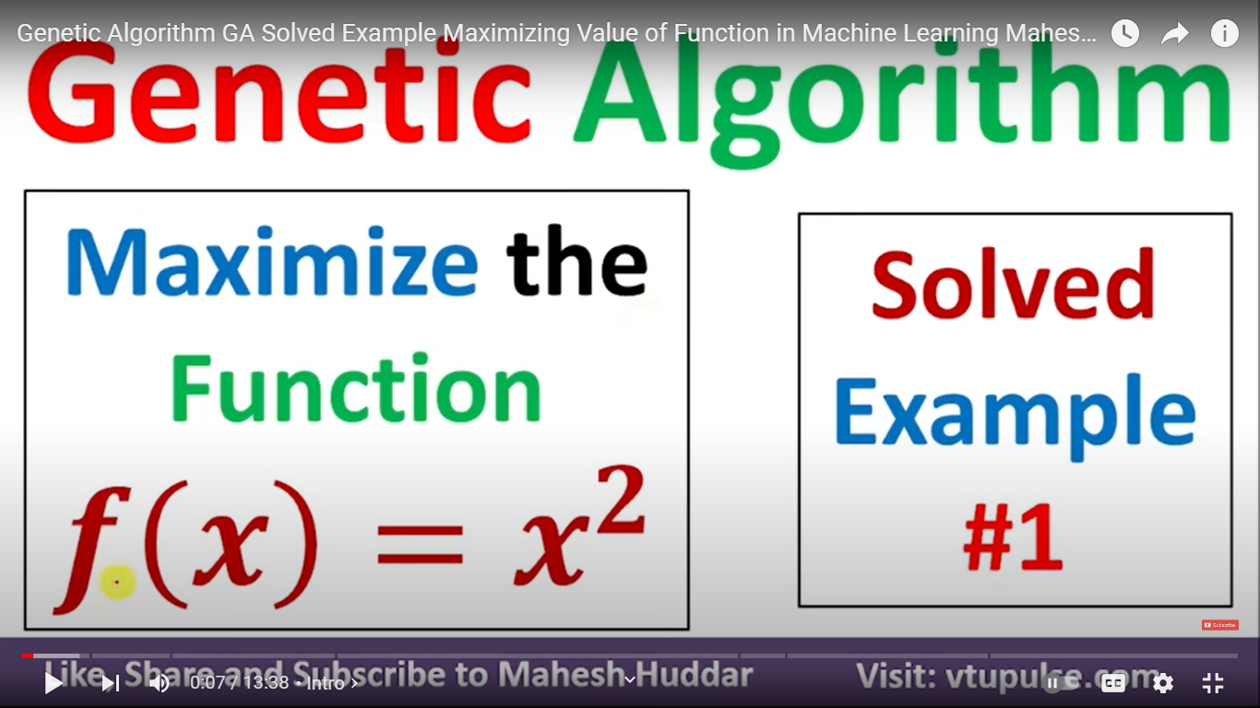

Slide 27
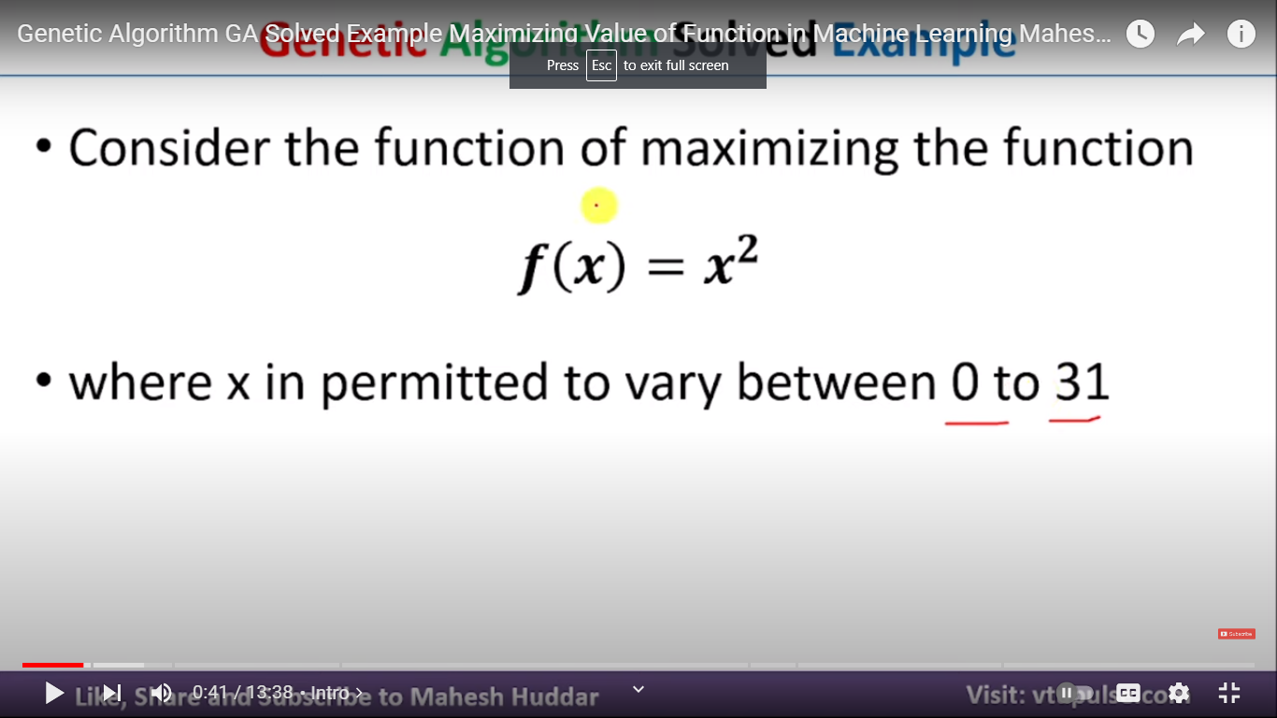

Slide 28
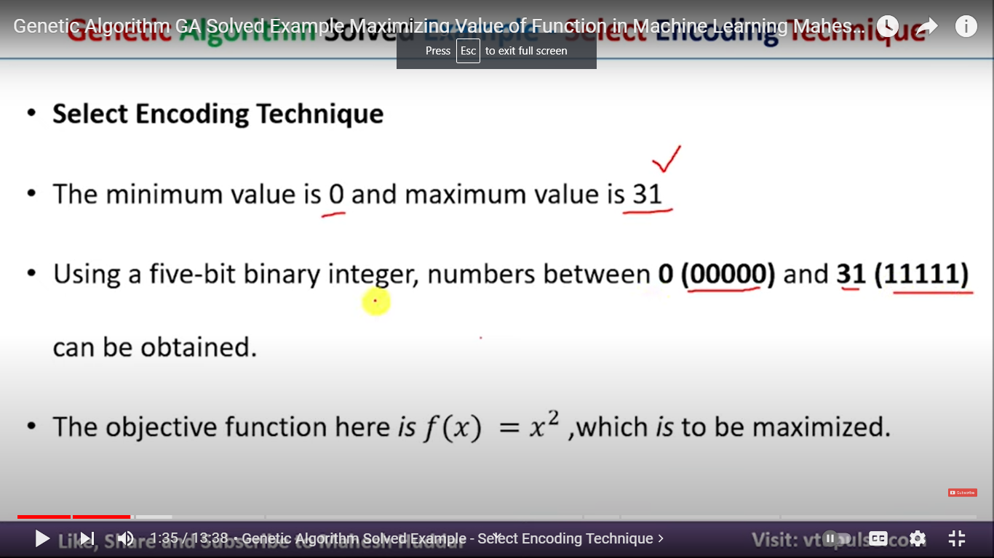

Slide 29
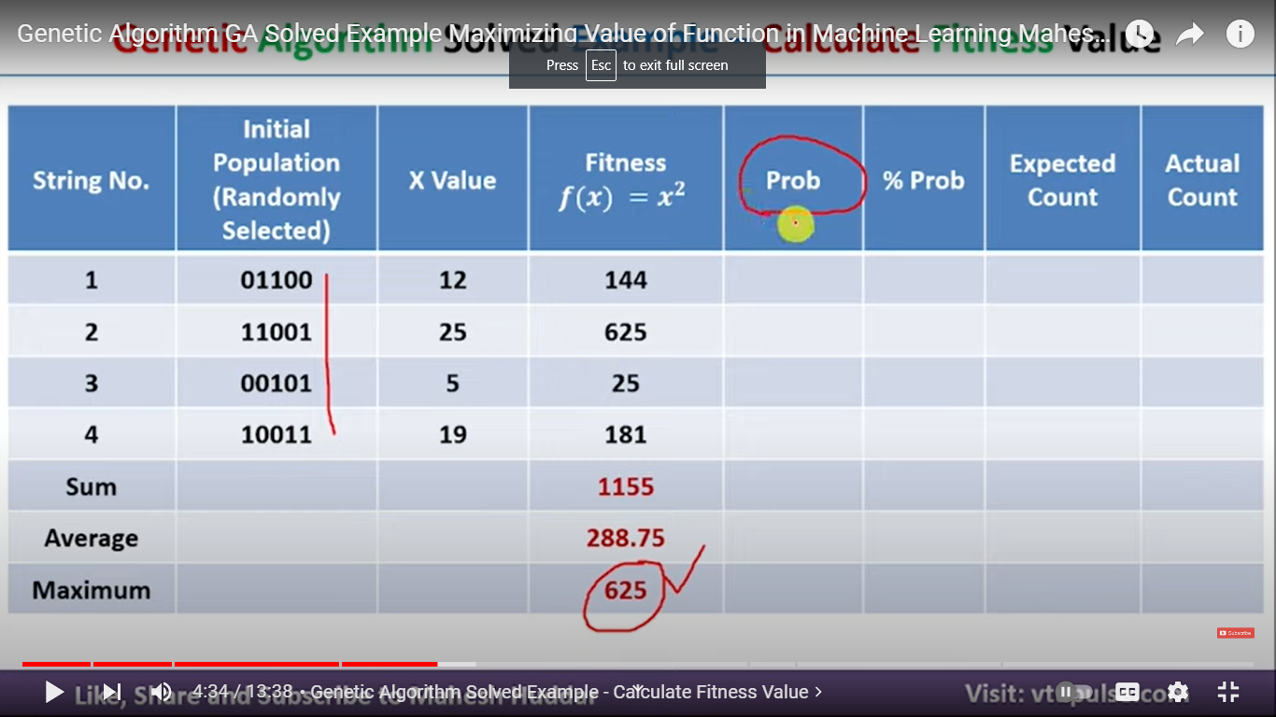

Slide 30
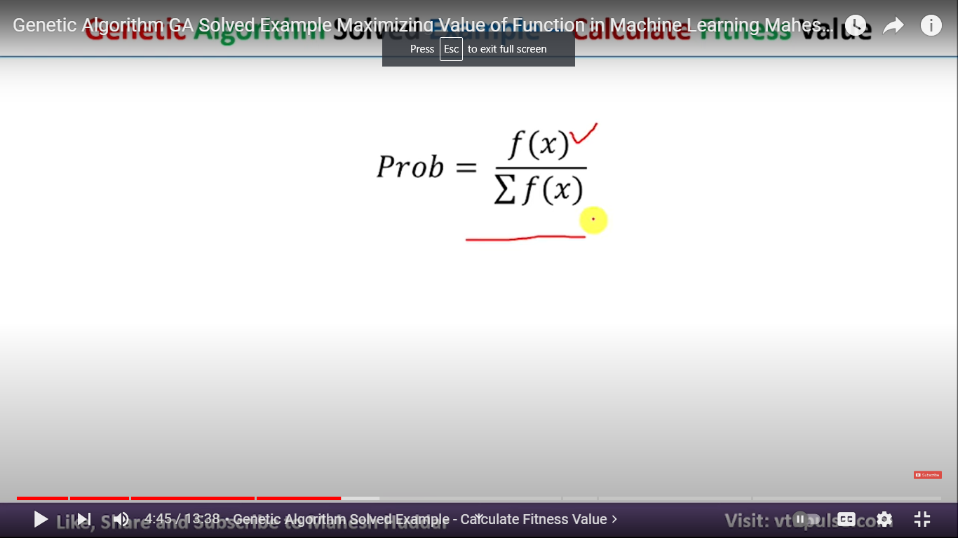

Slide 31
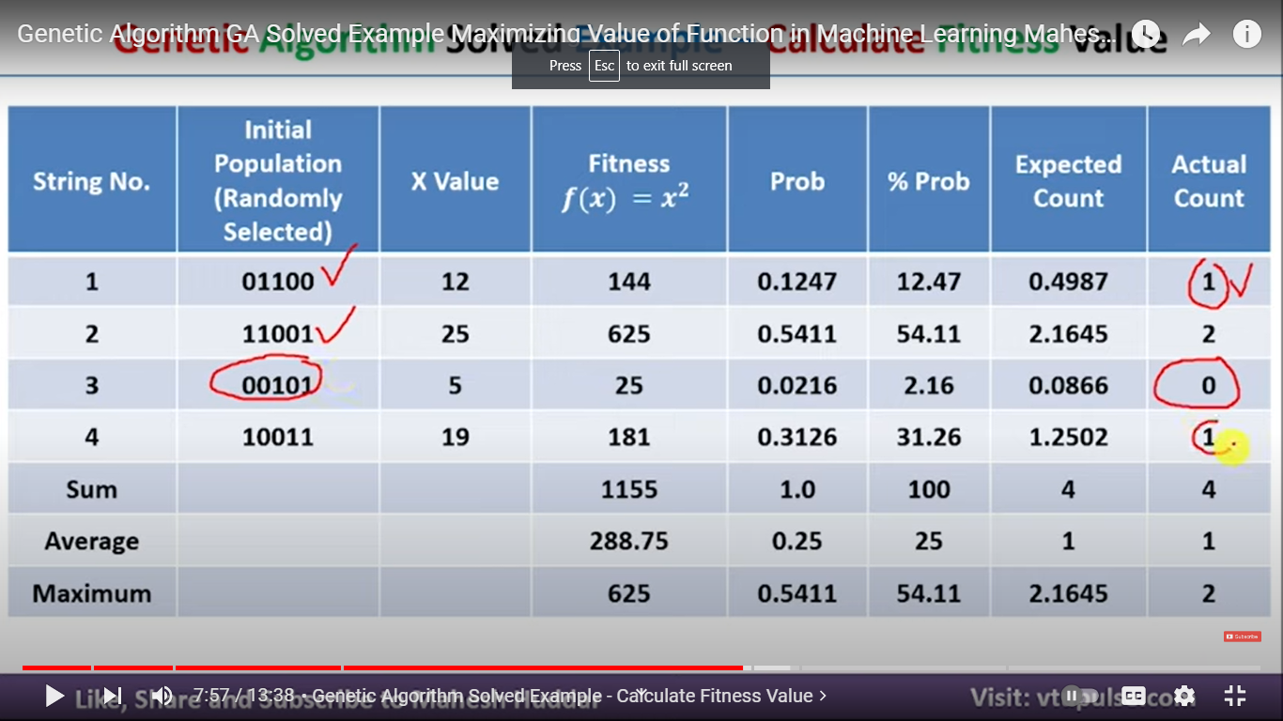

Slide 32
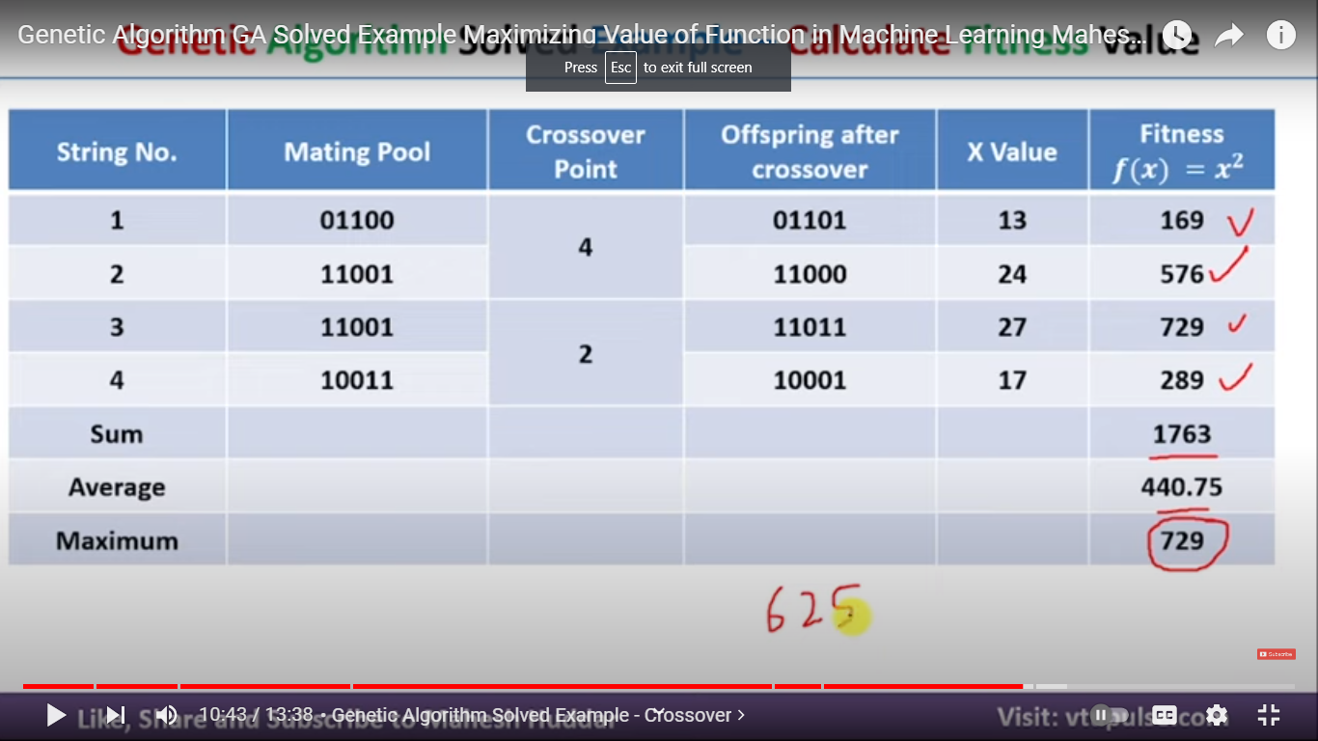

Slide 33
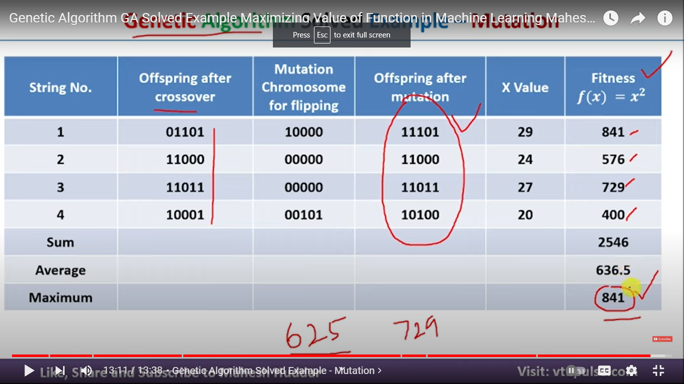

Slide 34
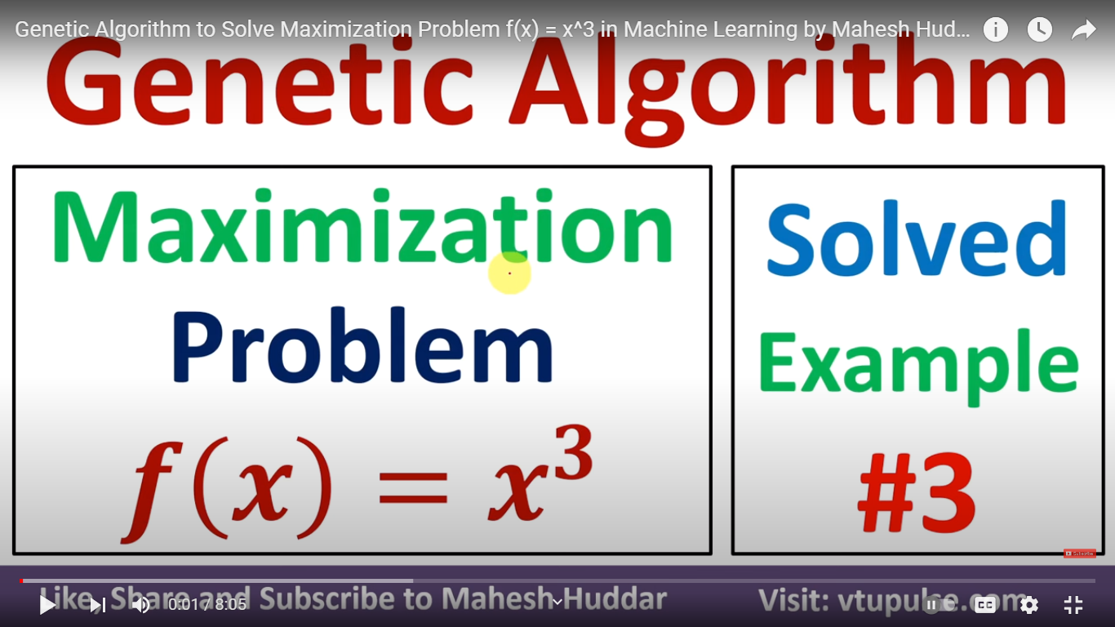
Example 3

Slide 35
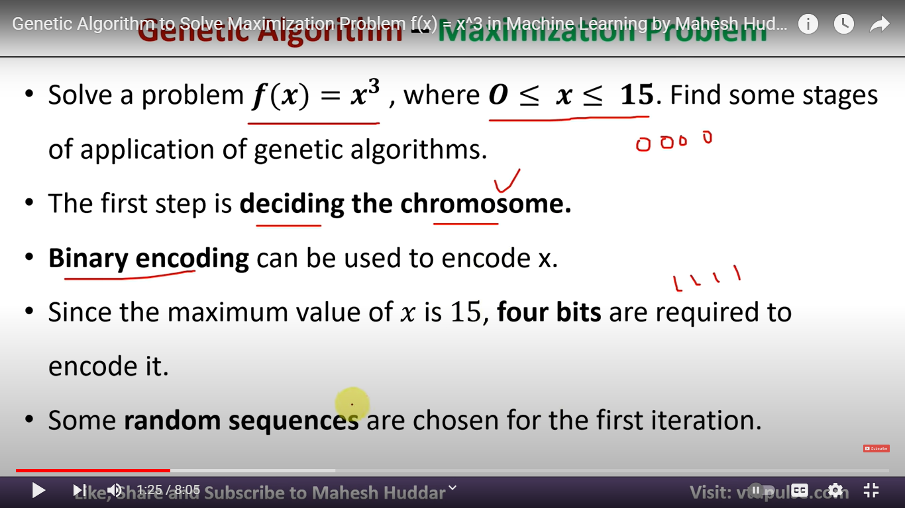

Slide 36
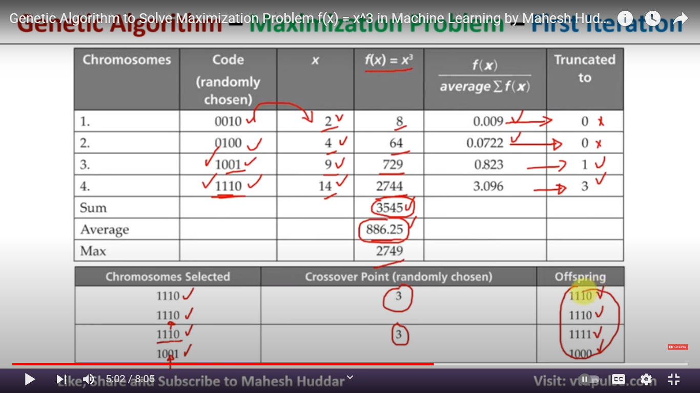

Slide 37
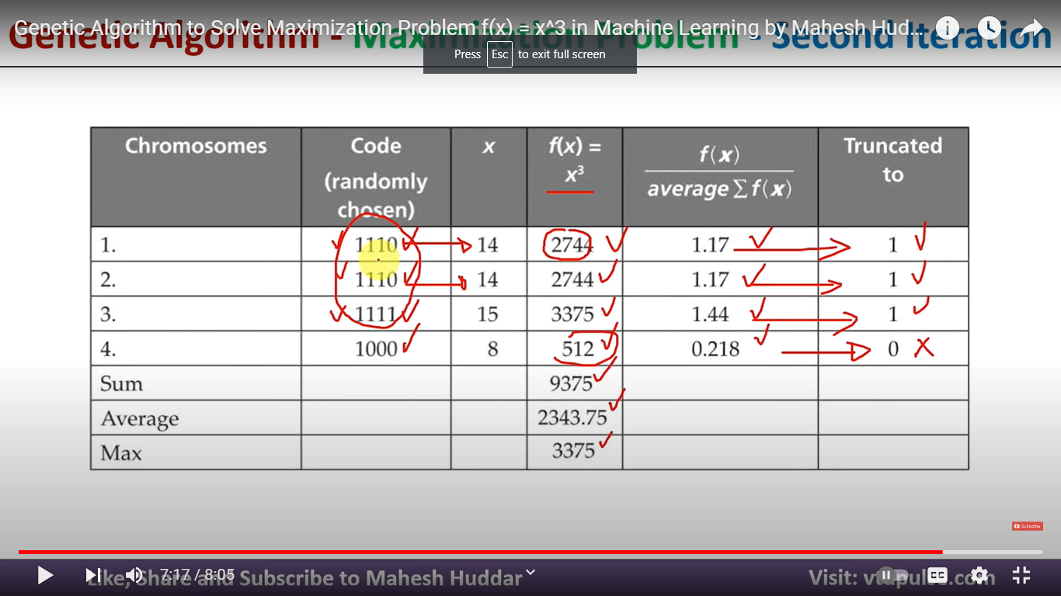

Slide 40
References
https://www.youtube.com/watch?v=Dj1AZ0T-m-I
https://www.toolify.ai/ai-news/maximizing-function-value-with-genetic-algorithms-solved-example-2280575
https://www.youtube.com/watch?v=Nvu7Klh_knM&t=230s

